Slide 1
https://qdata.github.io/deep2Read/
Defending Against Neural Fake News
Zellers et al.
2019
Presented by Eli Lifland, 11/15/2019

Slide 2
Fake news: background
Fake news: News designed to intentionally deceive
Most current fake news is manually written
Progress in language generation makes it easier to artificially generate ‘neural’ fake news
Focus on text-only documents with two goals
Monetization: Get clicks to increase ad revenue
Propaganda: Communicate targeted information
Current detection efforts:
Manual fact-checking e.g. Politifact
Automated detection of stylistic biases
However, fact checking not a panacea due to cognitive biases

Slide 3
Threat Model
Adversarial game with 2 players
Adversary: Generates fake stories which are either viral or persuasive, which must read realistically to humans and verifier
Verifier: Classifies stories as real or fake. Has access to unlimited real news stories and a few fake news stories from a specific adversary

Slide 4
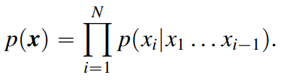
Text generation
Current SOTA: unconditional generation
Including metadata leads to joint distribution

Slide 5
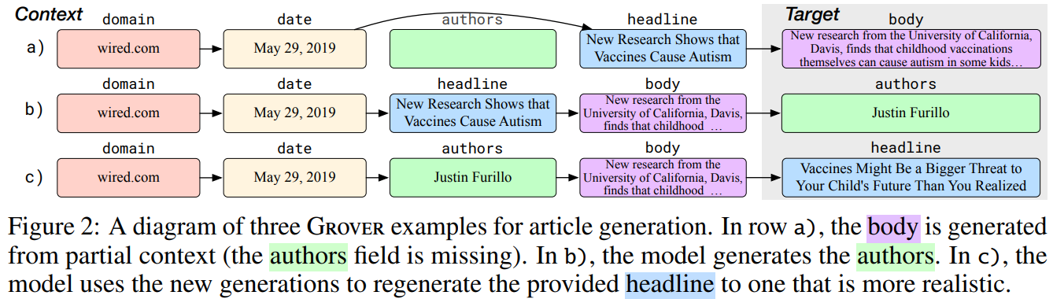
Text generation
At inference time, sort context fields in standard order, append field-specific start token, then sample from model

Slide 6
Model training
Simulate inference by partitioning article’s fields into disjoint sets, randomly drop out fields, then predict tokens in first set followed by tokens in second set
Architecture: Same as GPT2
GROVER-Base: same size as GPT/BERT-Base
GROVER-Large: same size as BERT-Large
GROVER-Mega: same size as GPT2
Dataset: RealNews scraped from Common Crawl
Learning: 2 weeks of training on 256 TPU cores
Notes:
The motivation of this project

Slide 7
Variance of generations
Choice of decoding algorithm is important
Likelihood-maximization works better for close-ended generation (e.g. translation) than open-ended
Use Nucleus Sampling (top-p)
For a given threshold p, at each timestep sample from most probable words with cumulative probability representing top-p% of vocabulary
Notes:
The motivation of this project

Slide 8
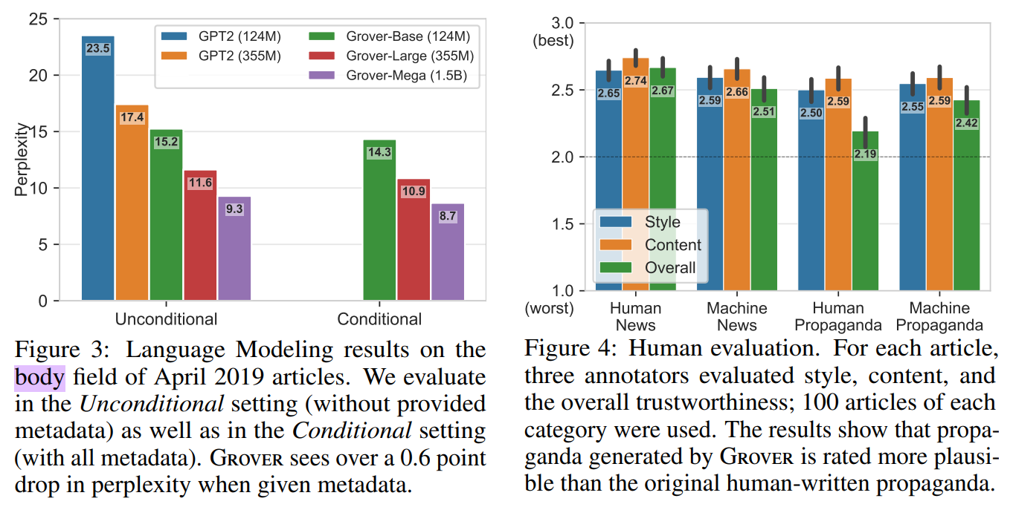
LM Results

Slide 9
Neural Fake News Detection
Use models for role of verifier: classifying articles as human or machine written
GROVER
GPT2
BERT
Fast Text
Semi-supervised setting
Access to entire RealNews training set
Limited access to generated articles; 10k using metadata from recent articles
Unpaired vs. paired evaluation
Notes:
The motivation of this project

Slide 10
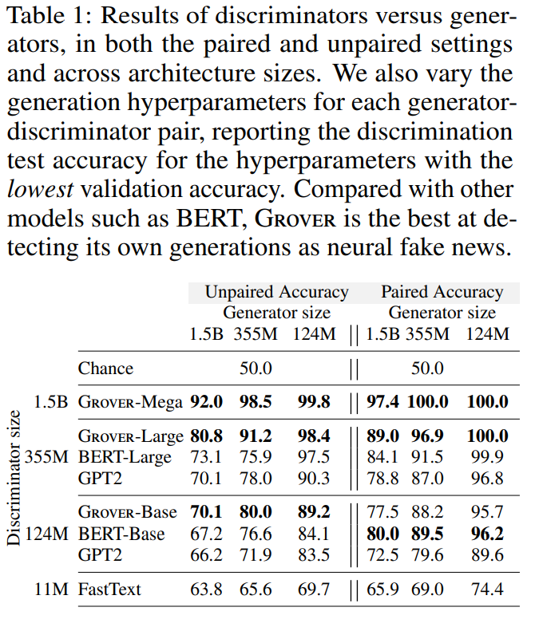
Neural Fake News Detection: Results
Notes:
The motivation of this project

Slide 11
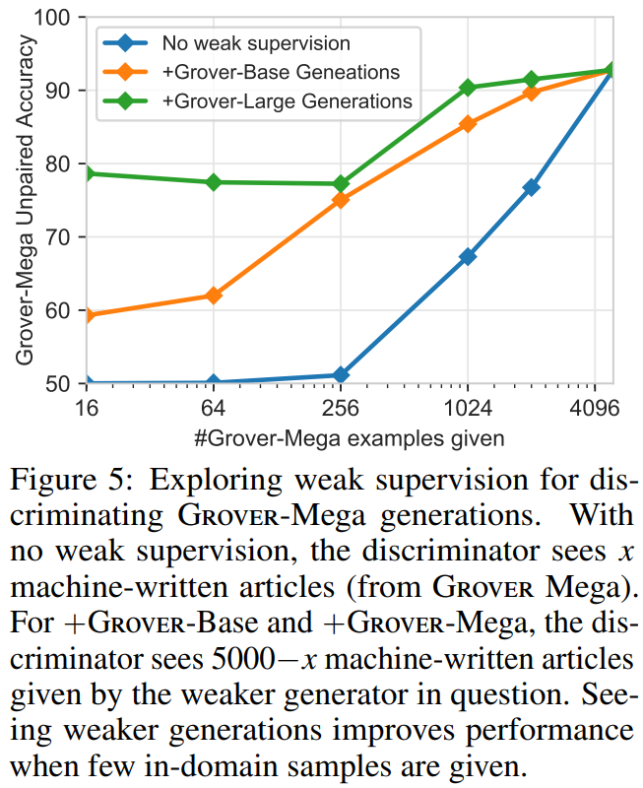
Neural Fake News Detection: Weak Supervision
Notes:
The motivation of this project

Slide 12
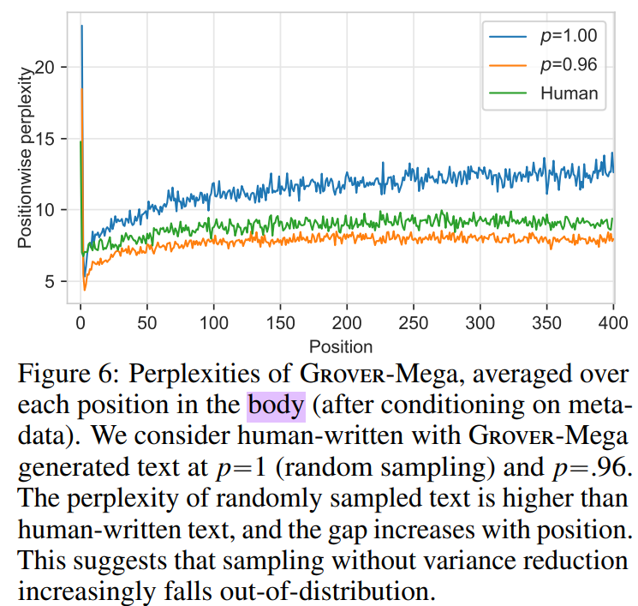
How does model distinguish?
Notes:
The motivation of this project

Slide 13
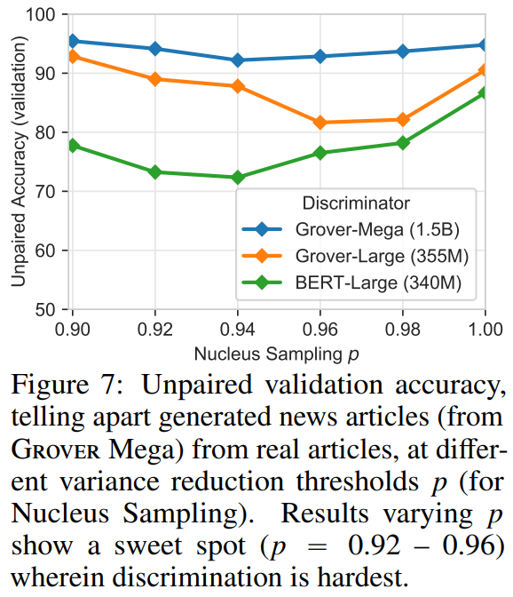
How does model distinguish?
Notes:
The motivation of this project

Slide 14
Conclusion/Future Work
Era of neural disinformation
Training GROVER-Mega cost “only” $25k
Release of generators is critical
GROVER is an effective detector of neural fake news
Additional threat models
Machine-generated real news
Integrating real-world knowledge into discriminator
Platforms should use NNs to flag news articles as they are published

